Slide 1
"Plant Leaf Disease Detection & Classification Using AI and Computer Vision Techniques"

Slide 2
Introduction
The objective of the project "Plant Leaf Disease Detection and Classification Using AI and Computer Vision Techniques" is to develop an intelligent system capable of identifying and classifying plant leaf diseases accurately and efficiently. By leveraging advanced AI algorithms and computer vision, the system aims to assist farmers and agricultural professionals in detecting diseases at an early stage, reducing crop losses and improving productivity.
This review explores automated techniques utilizing image processing, machine learning, deep learning, and few-shot learning for plant disease detection. Traditional machine learning approaches often lack robustness and are confined to controlled laboratory settings [3]. In contrast, deep learning has recently demonstrated remarkable success in classifying plant disease images. However, deep learning methods require extensive datasets, with images meticulously annotated by pathologists and botanists. These processes are resource-intensive and costly.

Slide 3
Phytopathology
Phytopathology refers to the study of plant pathogens, the diseases they cause, their mechanisms, and methods to control and mitigate their impact on plants. Derived from Greek, "Phytopathology" combines "Phyto" (plant), "Patho" (disease), and "Logo" (knowledge) [6]. Its core objectives include investigating the origins and causes of plant diseases, whether biotic or abiotic (etiology), understanding the mechanisms behind disease development (pathogenesis), examining interactions between plant pathogens and diseases (epidemiology), and developing strategies to reduce damage and manage losses, as depicted.
Pathogenesis
Control and Management
Phytopathology Objectives
Etiology
Epidemiology

Slide 4
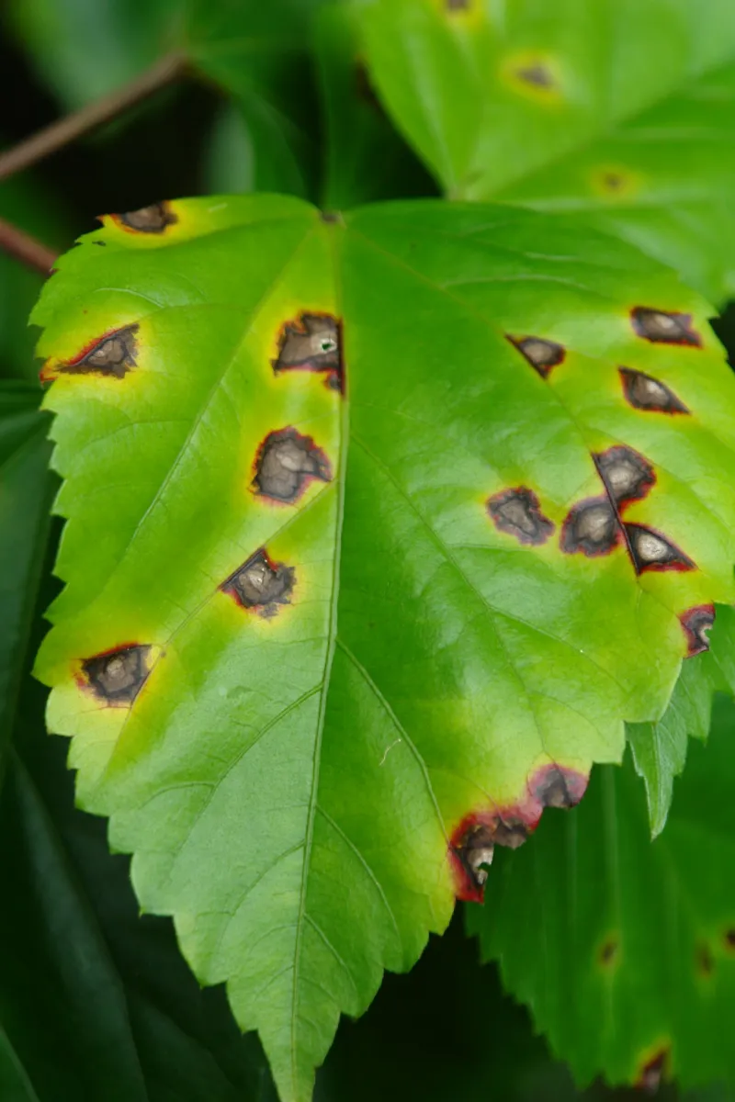
Plant Disease Types
Bacterial Diseases:
Bacterial infections in plants typically begin as water-soaked lesions that develop into small green blemishes. Over time, these lesions expand and dry into dead spots, as illustrated. For instance, foliage may display water-soaked black blemishes, brown leaf spots, or yellow halos of uniform size. Under dry conditions, the blemishes often appear dappled. Bacterial wilt, a common issue in brinjal crops, causes the entire plant to collapse [7].

Slide 5
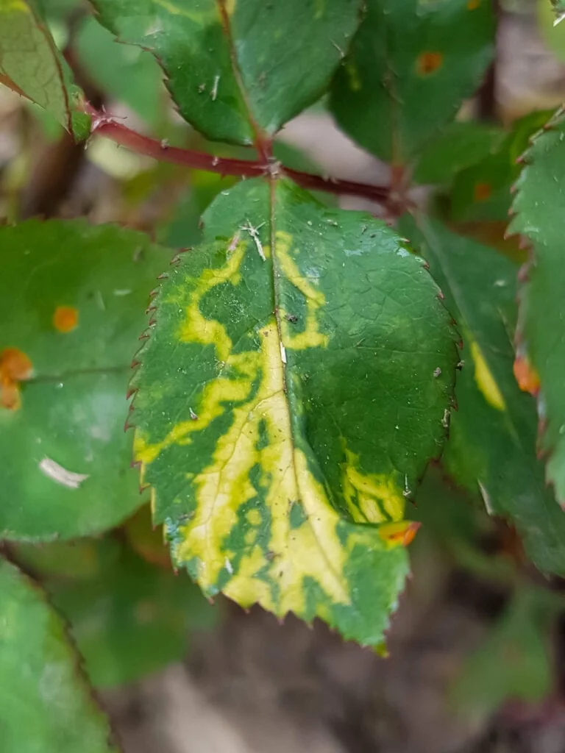
Plant Disease Types
2. Viral Diseases:
Viral infections in plants are among the most challenging to diagnose, as they may exhibit no visible symptoms or mimic signs of herbicide damage or nutrient deficiencies [7]. Commonly observed viral diseases include those transmitted by beetles, leafhoppers, aphids, and whiteflies, such as mosaic viruses, which manifest as green or yellow streaks on foliage, as shown in Fig.

Slide 6
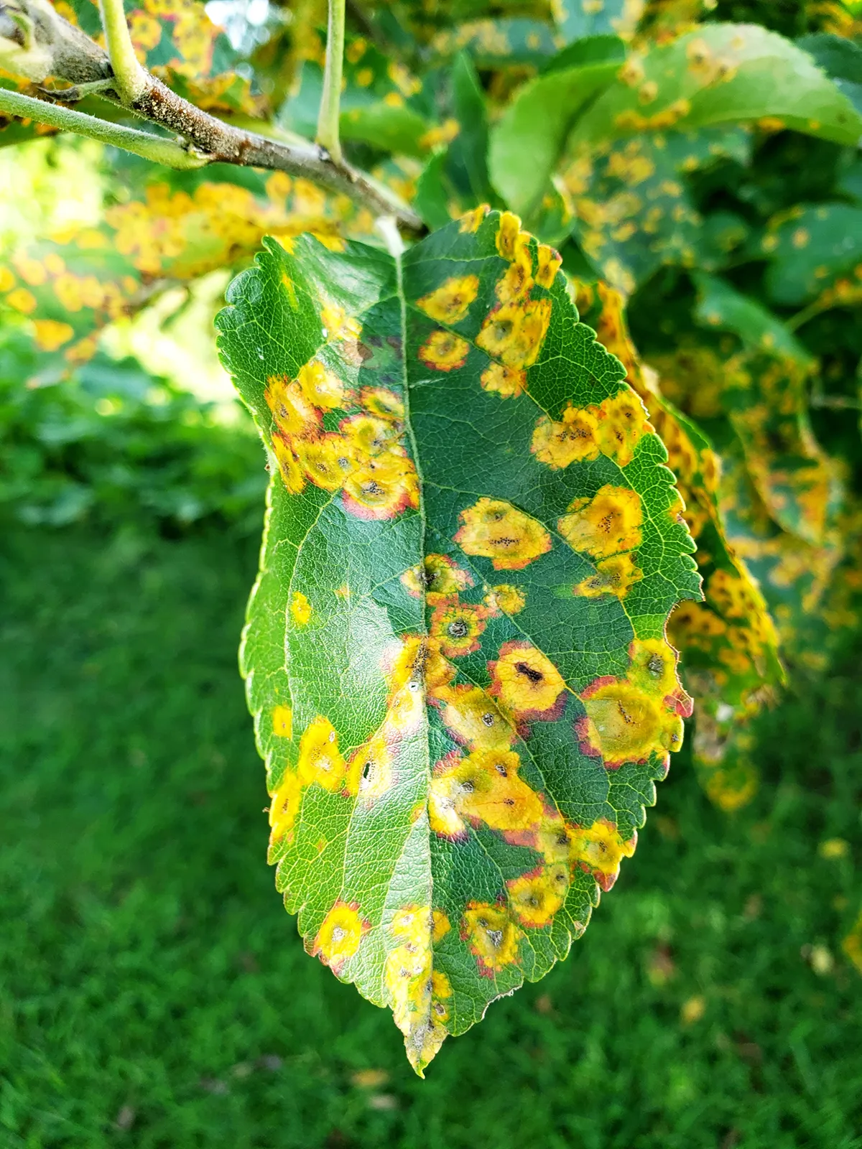
Plant Disease Types
3. Fungal Diseases:
Fungal infections affect various parts of plants, including stems, leaves, seeds, and roots. Examples include sclerotium wilt, stem rust, blight, ergot, and carnal bunt. Late blight caused by Phytophthora fungus initially appears as gray-green waterlogged blemishes on older leaves, as shown in Fig. 3. Over time, these lesions darken, and white fungal growth may appear due to fluctuating wet and dry conditions [8]. Rust fungi form spots on mature leaves that turn black over time, as illustrated in Fig.

Slide 7
Plant Disease Detection System
This review aims to explore various approaches employed by researchers, including Machine Learning (ML), Deep Learning (DL), Few-Shot Learning (FSL), and soft computing techniques integrated with image processing for analyzing RGB and Hyperspectral Images. Additionally, Molecular Techniques are discussed, which have been developed to prevent and mitigate pathogenic threats effectively.
MACHINE LEARNING
DEEP LEARNING
FEW-SHOT LEARNING
HYPERSPECTRAL IMAGING
MOLECULAR DIAGNOSIS

Slide 8
Plant Disease Detection System
Machine Learning:
The process of detecting plant diseases using machine learning and image processing follows a series of sequential steps: Image Acquisition, Image Preprocessing, Image Segmentation, Feature Extraction and Selection, and Classification [17]. These steps are detailed below, along with key approaches proposed in the literature.

Slide 9
Plant Disease Detection System
Deep learning:
It is a hierarchical approach to machine learning, enabling object detection [46], image classification, and NLP. It builds high-level features by combining low-level ones, enhancing generalization and accuracy compared to traditional ML techniques.
Modern DL techniques automatically select features, forming high-level representations by combining lower-level ones. Advanced neural networks include convolutional neural networks (CNNs), multilayer perceptrons, and recurrent neural networks. Prominent CNN architectures such as Alex-Net, Google-Net, VGG-Net, Mobile-Net, Res-Net, and Efficient-Net have been developed over time.

Slide 10
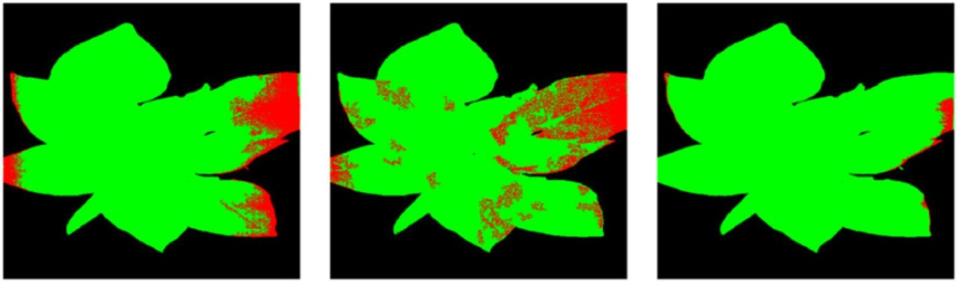
Plant Disease Detection System
Hyperspectral Imaging:
Plant diseases are sometimes challenging to detect through computer vision systems or visual inspection due to the growth stages of pathogens.
Hyperspectral imaging sensors, operating primarily within the electromagnetic spectrum range of infrared and visible light (400–2500 nm), capture detailed information across a wide range of bands. Hyperspectral imaging has proven effective for early-stage plant disease detection. Wang et al. (2019) [56] proposed a GAN-based model called OR-AC-GAN (Outlier Removal—Auxiliary Classifier GAN) for detecting tomato leaf diseases, achieving 96.25% accuracy.
(a) DirectCNN (b) AC-GAN (c) OR-AC-GAN
Segmentation Comparison

Slide 11
Plant Disease Detection System
Few – Shot Learning:
It is a machine learning technique that uses a small number of labeled examples to train an AI model to make predictions. It's used when there's not enough training data available.. FSL leverages prior knowledge and datasets during training, optimizing data and models to generate source tasks.
Key FSL Techniques:
• Embedding: This involves feature extraction or dimensionality reduction techniques. Pre-trained CNNs (e.g., ImageNet) reduce training time, while SVM with distinct kernels classifies complex systems.
• Multitask Learning: A shared model trains multiple tasks using either hard parameter sharing (HPS) or soft parameter sharing (SPS). In HPS, common parameters are shared across tasks, while SPS trains specific features for individual tasks.

Slide 12
Plant Disease Detection System
Molecular Diagnosis Techniques:
Pests and diseases can cause up to 35% losses in global food production. Early detection is crucial to prevent outbreaks of severe plant diseases caused by pathogens such as nematodes, viruses, bacteria, fungi, and oomycetes. Molecular diagnostic techniques bridge the gap between traditional methods and the need for precise disease management.
Below are key molecular diagnosis technologies:
• ELISA (Enzyme-Linked Immunosorbent Assay): Widely used in plant pathology, ELISA detects specific substances in samples via antibody-enzyme interactions, leading to a color change. However, it has limitations in sensitivity and specificity, especially for bacterial pathogens.
• Conventional PCR: This molecular biology technique amplifies DNA sequences using electrophoresis for pathogen detection. While sensitive, it is susceptible to contamination and false positives.
• RT-PCR (Real-Time PCR): A quantitative PCR method offering high sensitivity and specificity for detecting DNA pathogens.

Slide 13
Methodology
Data Collection
Data Preprocessing
Feature Extraction
Model Selection & Training
Performance Evaluation & Optimisation

Slide 14
Challenges
Dataset Availability.
Difficulty in obtaining samples for specific diseases.
Lack of expert annotators capable of accurately differentiating between dead plants and those infected by disease. This task demands skilled professionals, which can be costly and particularly challenging for rare or newly emerging diseases.
Many studies rely on the Plant Village dataset, which consists of laboratory images, rather than real-time images, significantly impacting classifier performance.
Designing systems that operate efficiently on constrained devices remains a challenge.
Improper tuning and selection of hyper parameters of a model can significantly impact system performance.

Slide 15
Conclusion
The emergence of plant pathogens poses a significant threat to global food security, ecosystems, and economies. Factors such as globalization, climate change, and pathogen evolution have accelerated the spread of invasive plant pathogens. To address agricultural losses, the development of automated approaches for plant disease detection and classification is urgently needed.
This review explores the use of machine learning (ML), deep learning (DL), and few-shot learning (FSL) for automated plant disease recognition. It highlights key methodologies, including acquisition, preprocessing, segmentation, feature extraction, and classification. While many studies rely on RGB images, some have adopted hyperspectral imaging for plant leaves, which offers the advantage of detecting microscopic symptoms without requiring labeled datasets.
These automated techniques have facilitated timely advancements in research. Additionally, the review examines molecular diagnostic tools for plant disease detection. The methods discussed are highly sensitive, specific, and capable of rapid detection.

Slide 16
Societal Benefit of the Project
Improved Crop Health and Yield
Empowering Farmers
Reduction in Chemical Usage
Economic Gains
Scalable and Efficient Disease Management

